Slide 1

Premier League Football Analysis
By Andrew Doran

Slide 2
Executive Summary
Goal of the project is to find predictors that can be used to predict individual games
Meant to create a predictive model capable of predicting a winner to be applied in the world of sports betting
Predictor 1: Home vs Away
Predictor 2: Previous position in league table
Predictor 3: Win streaks

Slide 3
Data collection process
Two csv files were used containing results and stats over the course of the 2006/2007 - 2017/2018 premier league season
https://www.kaggle.com/datasets/zaeemnalla/premier-league/
API was difficult and not useful towards analysis
Data was very disorganized
Machine Learning needed

Slide 4
Home vs Away
Home field advantage
Quantify how strong home advantage is
Look at each team to see what teams have stronger advantages

Slide 5
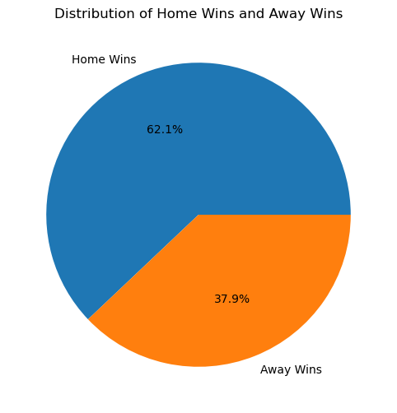
Pie Chart

Slide 6
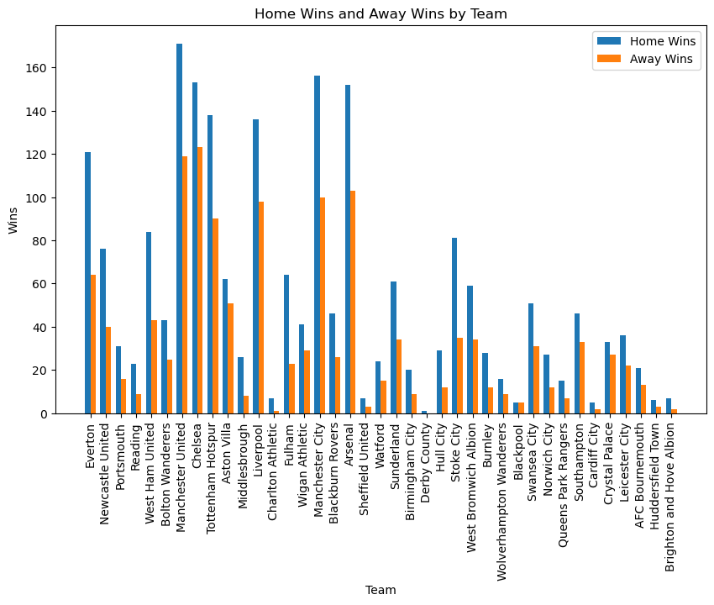

Slide 7
Two paired t-test results
Ho: There is no significant difference between home and away wins.
Ha: There is a significant difference between home and away wins.
T-score = 7.803
p-value = 2.42e-07
There is a significant difference in home vs away wins at α = 0.05..

Slide 8
Previous position in league table
Does previous position effect how successful a team is in the next year
Look at the specific 2006/2007 season
Compare how many points were given up by each team in the following season

Slide 9
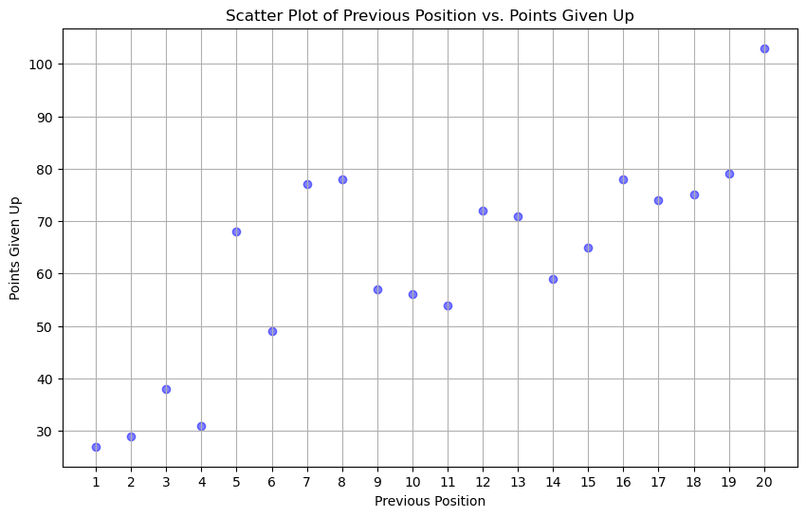

Slide 10
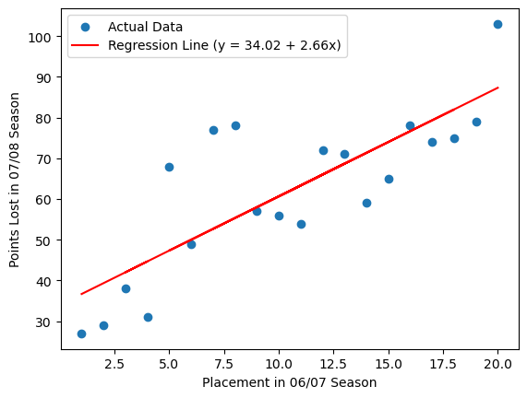

Slide 11
Linear Regression Results
Ho: There is no significant linear correlation between previous position and points given up.
Ha: There is a significant linear correlation between previous position and points given up.
R-squared value: 0.64
P - value = 0.000024
There is a significant difference in home vs away wins at α = 0.05.

Slide 12
Win Streak % Analysis
Team mentality going into next games
Overall team strength as a quantifier as well
Comparing win % after 2 wins, 3 wins, and overall win %

Slide 13
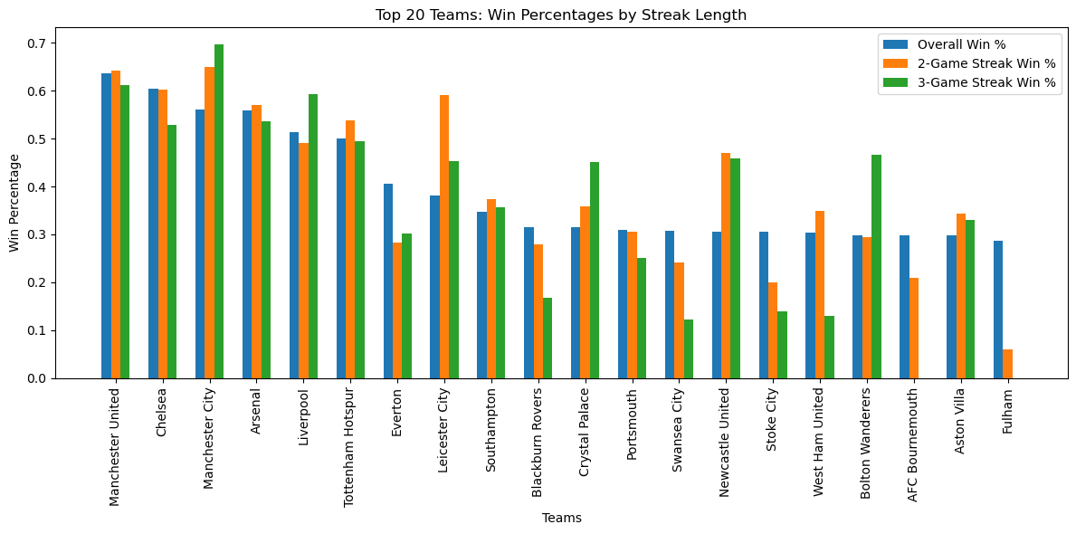

Slide 14
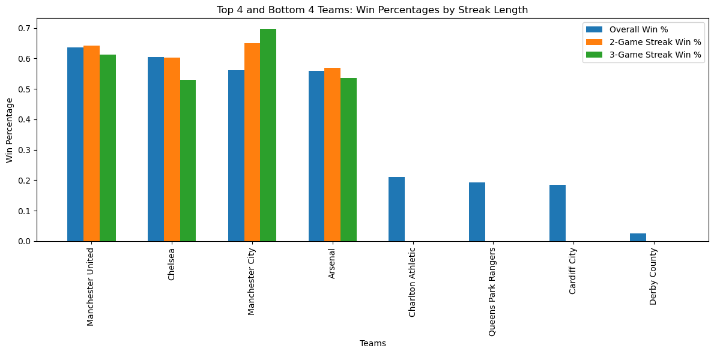

Slide 15
ANOVA test results
Ho: There is no significant difference between overall win percentage and win percentage after 2 and 3 game win streaks.
Ha: There is a significant difference between overall win percentage and win percentage after 2 and 3 game win streaks.
f-statistic = 0.475
p-value = 0.623
There is not a significant difference in overall win percentage and win percentage after a 2 game and 3 game win streak at α = 0.05. α = 0.05

Slide 16
Conclusion
Being the home team is a huge advantage
Previous position is a very strong indicator in how a team will perform
Win - Streaks are seemingly unimportant
Overall mildly successful results
Would like to spend more time analyzing in-game factors
Need more tools to create an effective model for predictive analysis

Slide 17
Questions?

